Slide 1
Bridge Tester ELM-4702 Projects II
Ben Holleran
Carter Mealey

Slide 2
What We Will Discuss
Course Outline
Our Selected Project
Project Background
Design Constraints
Troitsky Competition and Specifications
Our Design Solution
Project Management
Subsystems designs
Technical Details
Conclusion

Slide 3
Course Outline
Design and build a project that satisfies customer’s project restrictions
Document engineering process throughout whole project
Exercise proper engineering techniques
Follow project throughout entire development lifecycle
Present project to peers and deliver to customer

Slide 4
Selected Project
Popsicle stick bridge crusher
Deliver to the VTC Civil Engineering departement
Meet all Troitsky Bridge Competition specifications

Slide 5
Project Purpose
To prepare VTC students for the annual Concordia University Troitsky Competition
Teach local High Schools about engineering and encourge them to persue STEM degrees

Slide 6
Project Sponsors
VTC Civil Engineering departement
Clients | John Diebold Gordon Reynolds
Budget | $3500

Slide 7
Design Specifications
1 meter span
10 Tons
Mobile enough to move between buildings
Load display visible across Judd Gym
Accurate to 1% Load
Precise to 1% between bridges
14” Piston Throw – Allows different height bridges to be tested
100mm x 200mm Crush plate as per competition specifications

Slide 8
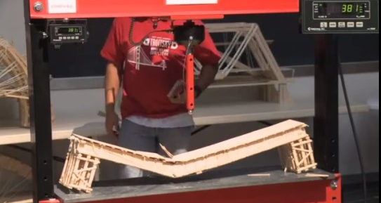
Troitsky Competition
Concordia University
Colleges compete to build the strongest bridge
Strongest bridge was made by MIT and held over six tons
Load display
(enlarged)
Piston and piston extender

Slide 9
Troitsky Competition History
Started in 1984
1991 first US team
1994, crusher exploded.
Mark on ceiling, Oil everywhere.
New crusher, max 6000lb
2000 new crusher. Hydraulic jack
2010 new crusher. Hydraulic jack

Slide 10
Final Design
Hydraulic cylinder and pump
AC electric motor
Truss instead of I-Beam to save weight
Raspberry Pi microcomputer as controller
I²C interface
Deflection data
Load data
HDMI monitor for load display and force over deflection readout

Slide 11
Project Management
Project to be Open Source
Github selected for project management
Version control
File management
Task tracking
Time management

Slide 12
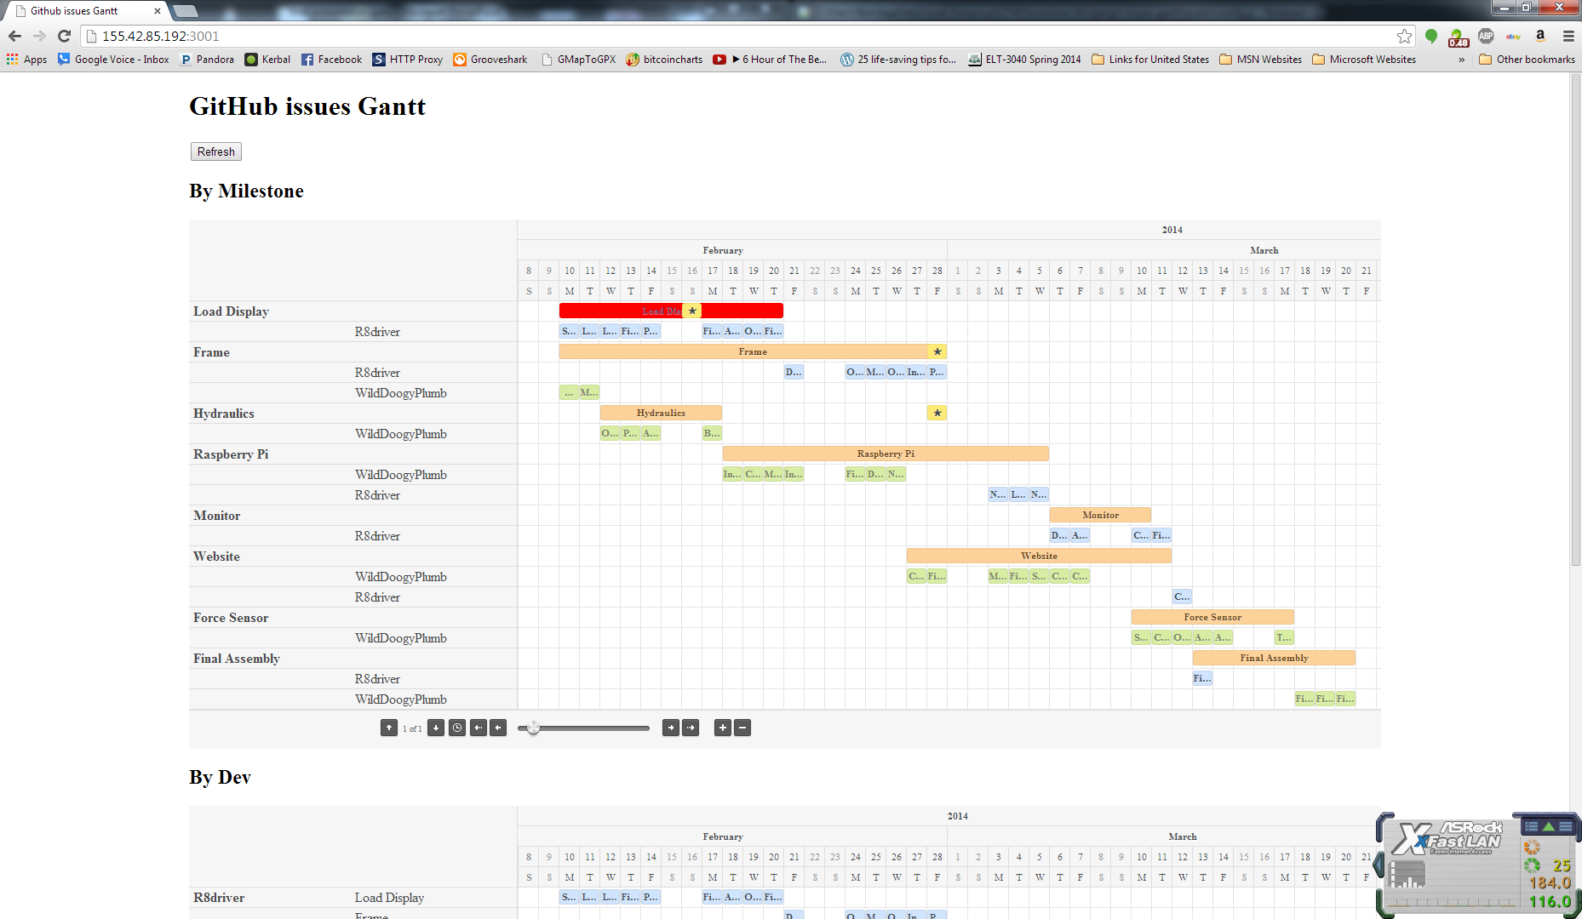
Work Breakdown Gaant Chart
Project managed via GitHub
Put Gaant chart screen shot here
Carter Ben

Slide 13
Final Budget
Name | Qt | Price | Shipping | Total
Electronics |  |  |  |  | $ 600.95
7 segment display | 5 | $ 16.46 | $ 15.00 | $ 97.30
Rasberry Pi | 1 | $ 55.00 | $ 12.72 | $ 67.72
Monitor | 1 | $ 136.00 | $ - | $ 136.00
hdmi cord | 1 | $ 5.79 | $ - | $ 5.79
i2c ADC | 1 | $ 14.95 | $ 4.07 | $ 19.02
Switches | 1 | $ 5.95 | $ - | $ 5.95
Misc | 1 | $ 150.00 | $ - | $ 150.00
Darlington Array | 6 | $ 2.00 | $ 4.43 | $ 16.43
USB external HDD | 1 | $ 28.00 | $ 7.49 | $ 35.49
7-Seg I2C | 5 | $ 5.95 | $ 7.50 | $ 37.25
Wireless router | 1 | $ 30.00 | $ - | $ 30.00
 |  |  |  | $ -
Hydraulics |  |  |  |  | $ 1,676.16
Pump | 1 | $ 171.75 | $ 24.32 | $ 196.07
Motor | 1 | $ 123.00 | $ - | $ 123.00
Cylinder | 1 | $ 236.50 | $ - | $ 236.50
Sensor (0-5V) | 1 | $391.50 | $ - | $ 391.50
Lines | 5 | $ 100.00 | $ - | $ 500.00
Valve | 1 | $ 85.00 | $ - | $ 85.00
Tank | 1 | $ 70.00 | $ - | $ 70.00
Filter housing | 1 | $ 40.00 | $ - | $ 40.00
Filter Cartridge | 1 | $ 20.00 | $ - | $ 20.00
 |  |  | $ - | $ -
Motor Coupling | 1 | $ 4.22 | $ - | $ 4.22
Pump Coupling | 1 | $ 5.29 | $ - | $ 5.29
Coupling Spider | 2 | $ 2.29 | $ - | $ 4.58
 |  |  | $ - | $ -
 |  |  |  | $ -
Mechanical |  |  |  |  | $ 491.52
Castors | 4 | $ 47.88 | $ - | $ 191.52
Misc Hardware | 1 | $ 300.00 | $ - | $ 300.00
 |  |  | $ - | $ -
 |  |  | $ - | $ -
 |  |  | $ - | $ -
 |  |  | $ - | $ -
 |  |  | $ - | $ -
 |  |  | $ - | $ -
 |  |  | $ - | $ -
Raw Materials |  |  |  |  | $ 315.21
Frame Steel | 0 | $ - | $ - | $ -
0 | .00 ft | $ 2.33 | $ - | $ -
0 | .00 ft | $ 3.63 | $ - | $ -
0 | .00 ft | $ 12.06 | $ - | $ -
Steel Cuts at Capitol | 6 | $ 10.00 | $ - | $ 60.00
 |  | $ - | $ - | $ -
 |  | $ - | $ - | $ -
Paint | 10 | $ 7.00 | $ - | $ 70.00
Aluminum plate 1'x6'x.5" | 1 | $ 185.21 | $ - | $ 185.21
Category | Total
Electronics | $ 600.95
Hydraulics | $ 1,676.16
Mechanical | $ 491.52
Raw Materials | $ 565.43
Total | $ 3,334.06

Slide 14
System Diagram
LCD Screen
Control box:
Raspberry Pi
I2C A2D
Force
Deflection
Switches
Hydraulic Handle
Pressure
Graph
Hydraulic
Cylinder
Bridge Goes Here
3in x 3in Hollow
Steel
Hydraulic Pump, Motor
Hydraulic Resevoir
Large Castors

Slide 15
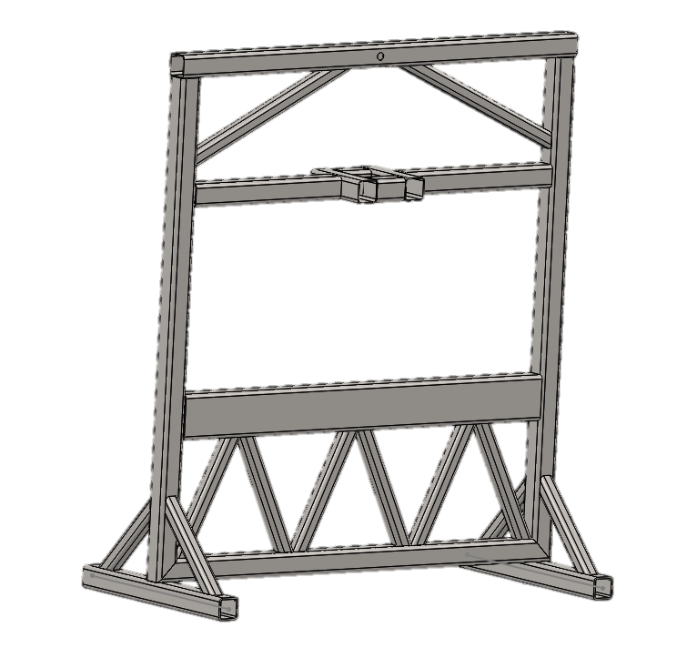
The Frame
Notes:
The frame is the structure that everything else is built on with this project. The above frame on the left shows the structure under maximum load with very exaggerated displacement visuals. There are a few more beams to be added to the frame but we are waiting on other key parts to fabricate mounting requirements after measurements.

Slide 16
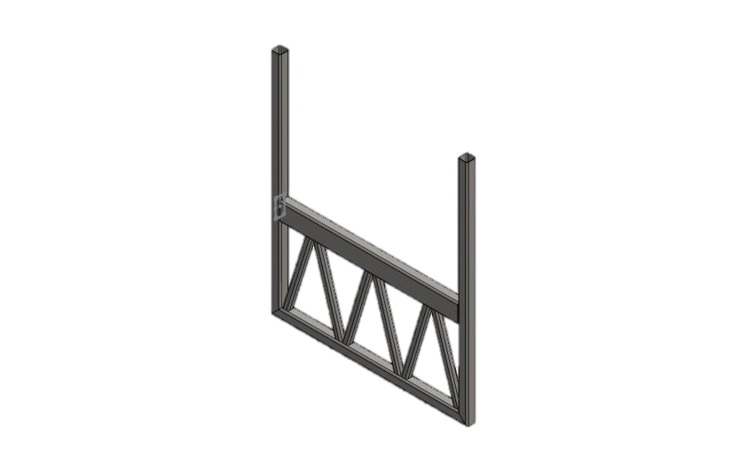
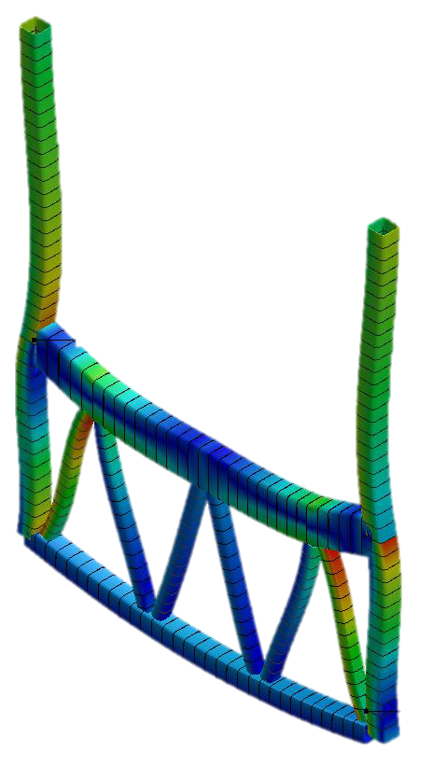
The Frame
Truss Is lighter and stiffer than I beam
Minimum Safety Factor of 4
Notes:
The frame is the structure that everything else is built on with this project. The above frame on the left shows the structure under maximum load with very exaggerated displacement visuals. There are a few more beams to be added to the frame but we are waiting on other key parts to fabricate mounting requirements after measurements.

Slide 17
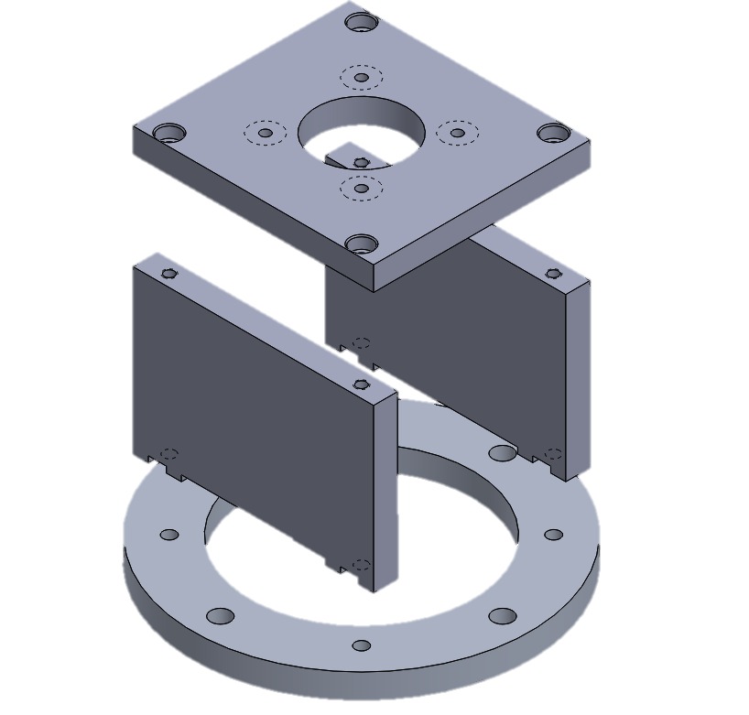
Motor to Hydraulic Pump Adapter

Slide 18
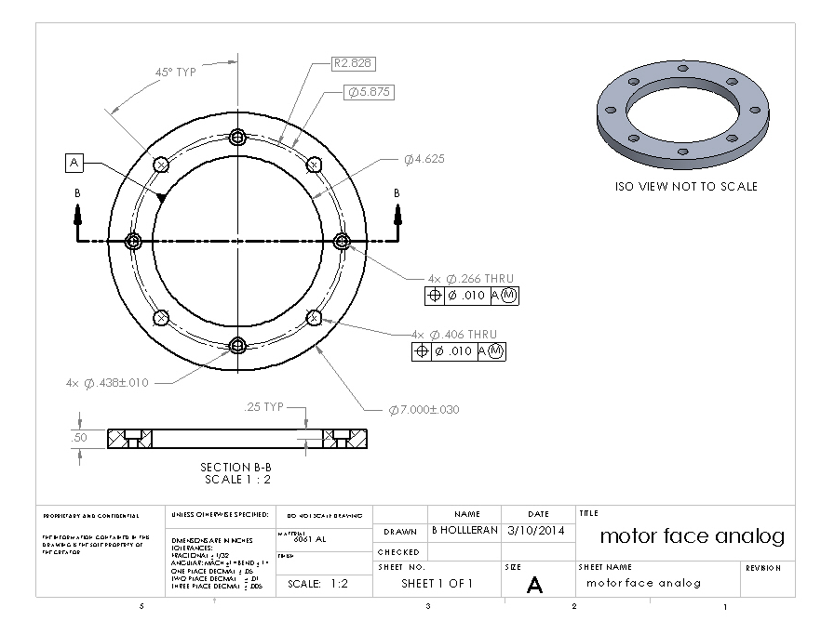
Motor Adaptor Plate

Slide 19
Hydraulic Subsystem
1 ½ NPT
¾ NPT
¾-16
½ NPT
Valve has built in pressure relief
¼ NPT
Pressure Sensor
Notes:
Our hydraulic system has is manually operated and has active extend and retract states. It is capable of outputting between 2K-3Ksi of pressure. It has a return tank and a gear pump with a manual handle.

Slide 20
Electrical Subsystem Diagram
Monitor
HDMI
Raspberry Pi
I²C
USB
ADC
ADC
Control Box
HDD
Pressure Sensor
Distance Sensor

Slide 21
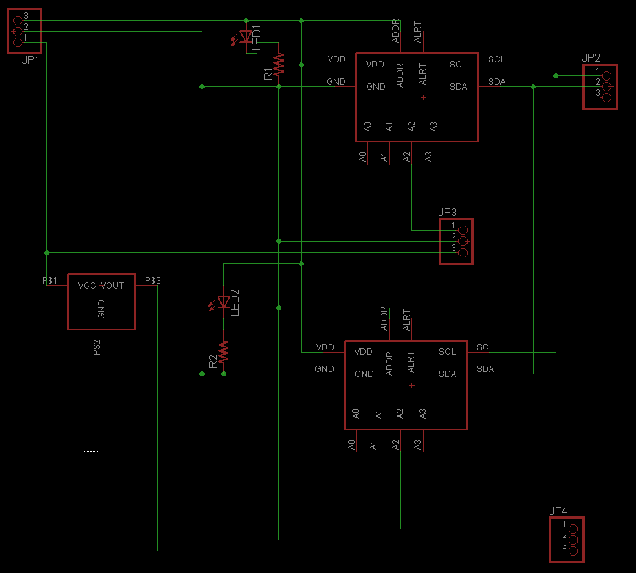
Electrical Schematic

Slide 22
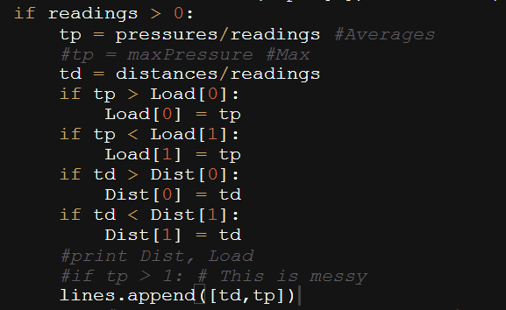
Software Overview
Software to be written in Python
Easy
Preexisting libraries
Interpreted (No compiling needed)
Integrated thread control
PyGame to draw to screen
Preinstalled on Pi

Slide 23
Software Diagram
Input Thread
Reads pressure sensor at 100Hz Reads distance at 10Hz Stores in list
Main Thread
Averages every 10 pressure readings
Draws to graph
Handles button presses
I²C
Sensor readings
List

Slide 24
Conclusion
In Conclusion:
Design meets Client specs
Design is constructible within timeframe
Design is within budget

Slide 25
Questions?

